Slide 1
Access to Vaccine for Children Providers and HPV Vaccination in Rural Children and Adolescents
Whitney E. Zahnd, PhD
Assistant Professor, Department of Health Management and Policy
Full Member, Holden Comprehensive Cancer Center
HPV Roundtable Annual Meeting

Slide 2
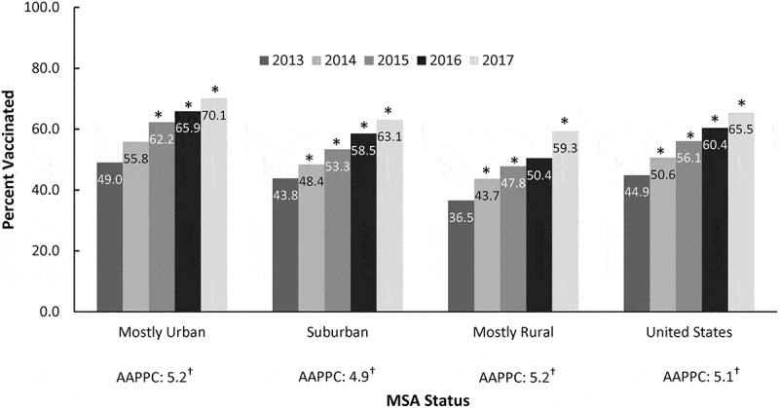
Rural Disparities in HPV-Associated Cancers and HPV Vaccination
Rural populations have higher rates of HPV-associated cancers than urban
Rural rates of HPV-associated cancers increased 19.3% between 1995 and 2013 while urban rates remained stable
Sources: Zahnd et al. CEBP, 2018; Walker et al. Hum Vaccin Immunother. 2020

Slide 3

Policy Approaches to Improve HPV Vaccination in Rural Communities
CDC Rural Cancer Policy Brief—offer HPV vaccination at lower out-of-pocket costs
Commentary by Vanderpool and colleagues identified participation in the Vaccine for Children program as a little “p” policy approach to increase vaccination in rural communities
Source: CDC; Vanderpool et al, 2019, Hum Vaccin Immunother.

Slide 5
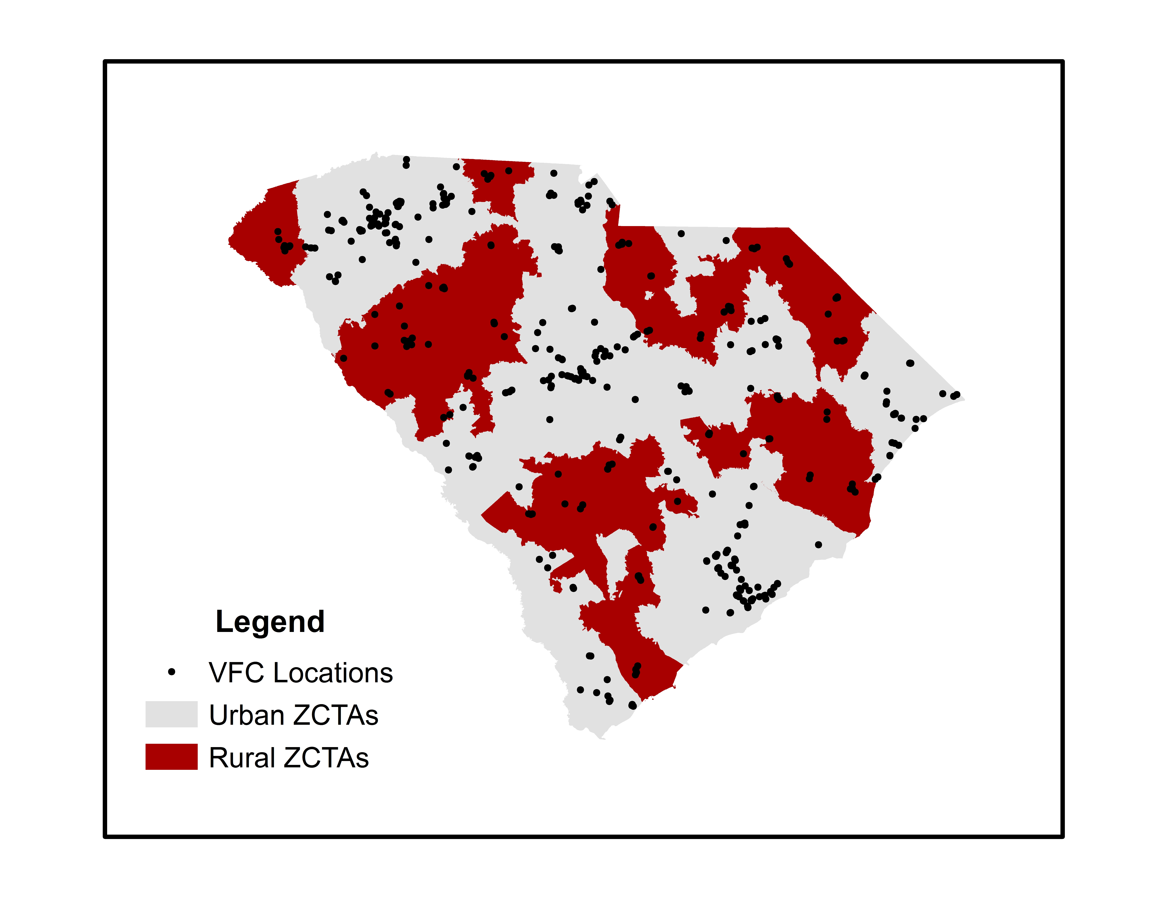
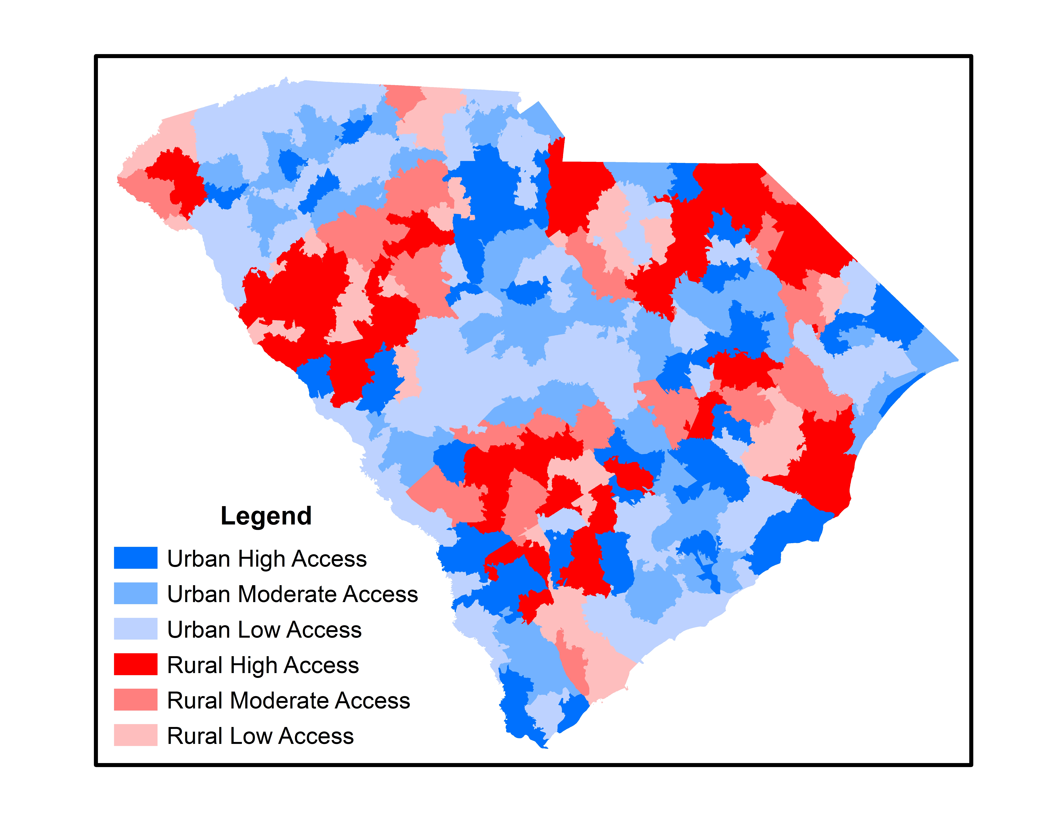
Access to Vaccine for Children Providers in SC

Slide 6
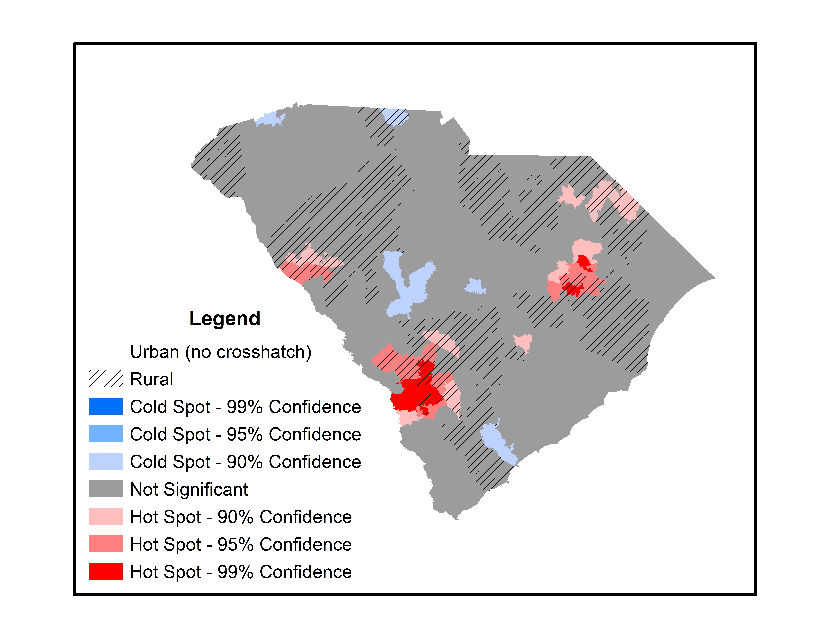
Access to Vaccine for Children Providers in SC
More “hotspots” of access in rural areas
Higher mean spatial accessibility scores in rural areas (0.000548 vs. 0.000419)
No rural-urban differences in mean distance to the nearest VFC provider (7.5 vs. 6.5 miles; p=0.06)

Slide 7
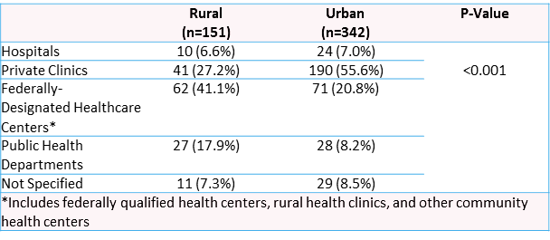
Access to Vaccine for Children Providers in SC

Slide 8
Key Takeaways
VFCs in South Carolina are an accessible avenue for HPV vaccination
Using spatial methods can help identify areas where there is additional need for vaccination services
Identifying the locations and types of VFC providers can help inform the planning and delivery of interventions
  In rural South Carolina, the plurality of VFC providers were in federally designated health centers

Slide 9
Acknowledgements and Funding
Funding:
This study was supported in part by the Federal Office of Rural Health Policy (FORHP), Health Resources and Services Administration (HRSA), U.S. Department of Health and Human Services (HHS) under U1CRH03711, as well as the SC Office of Rural and Primary Healthcare. The information, conclusions, and opinions expressed are those of the authors, and no endorsement by FORHP, HRSA, or HHS is intended or should be inferred.
Collaborators:
Radhika Ranganathan, MPhil
Heather Brandt, PhD
Sayward Harrison, PhD
Swann Arp Adams, PhD
Jan Eberth, PhD

Slide 10


Thank you! whitney-zahnd@uiowa.edu
@whitneyzahnd

