Slide 1
Responding to addiction in rural communities
Christina M. Andrews, Ph.D., Associate Professor
Affiliate, Rural and Minority Health Research Center
Department of Health Services Policy and Management

Slide 2
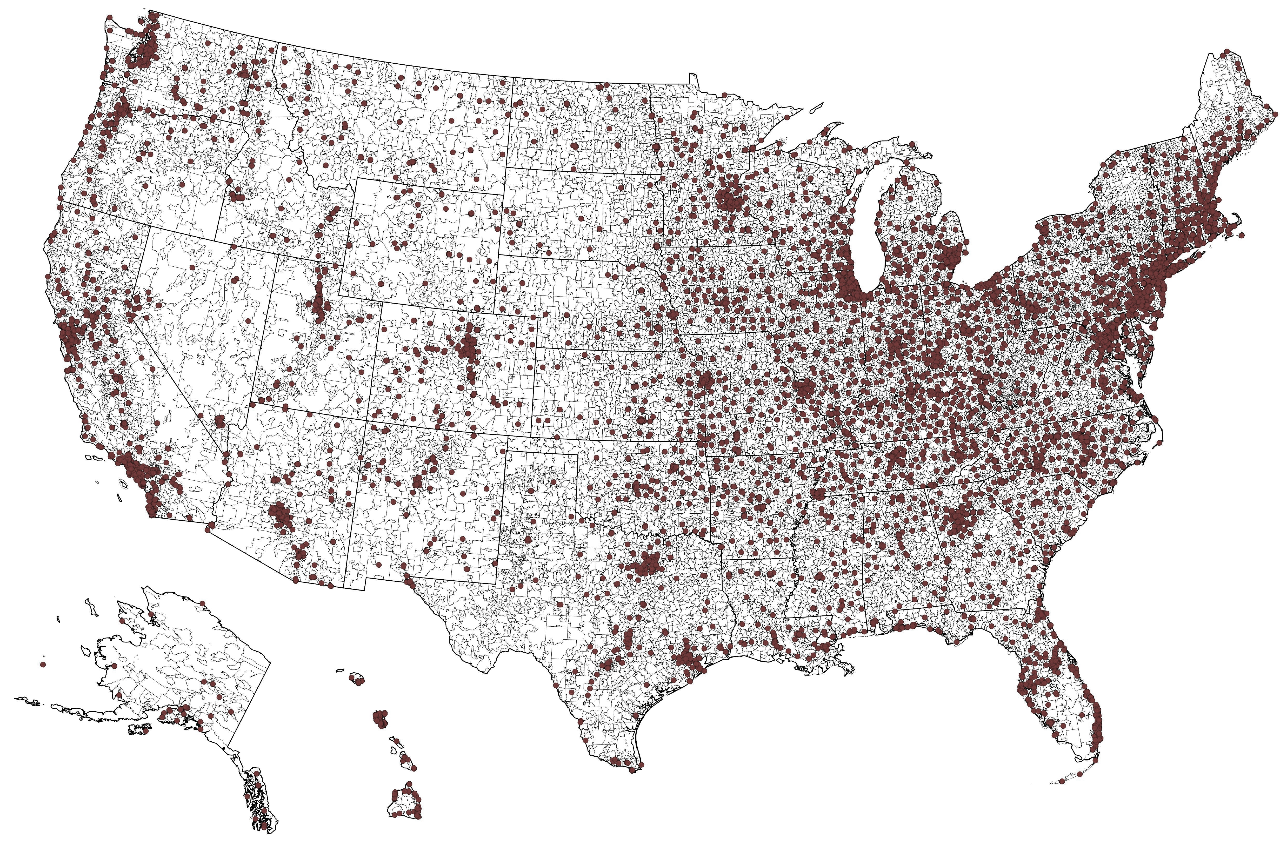
Addiction Treatment Programs in the United States, 2020
SOURCE: Substance Abuse and Mental Health Services Administration Behavioral Health Treatment Locator

Slide 3
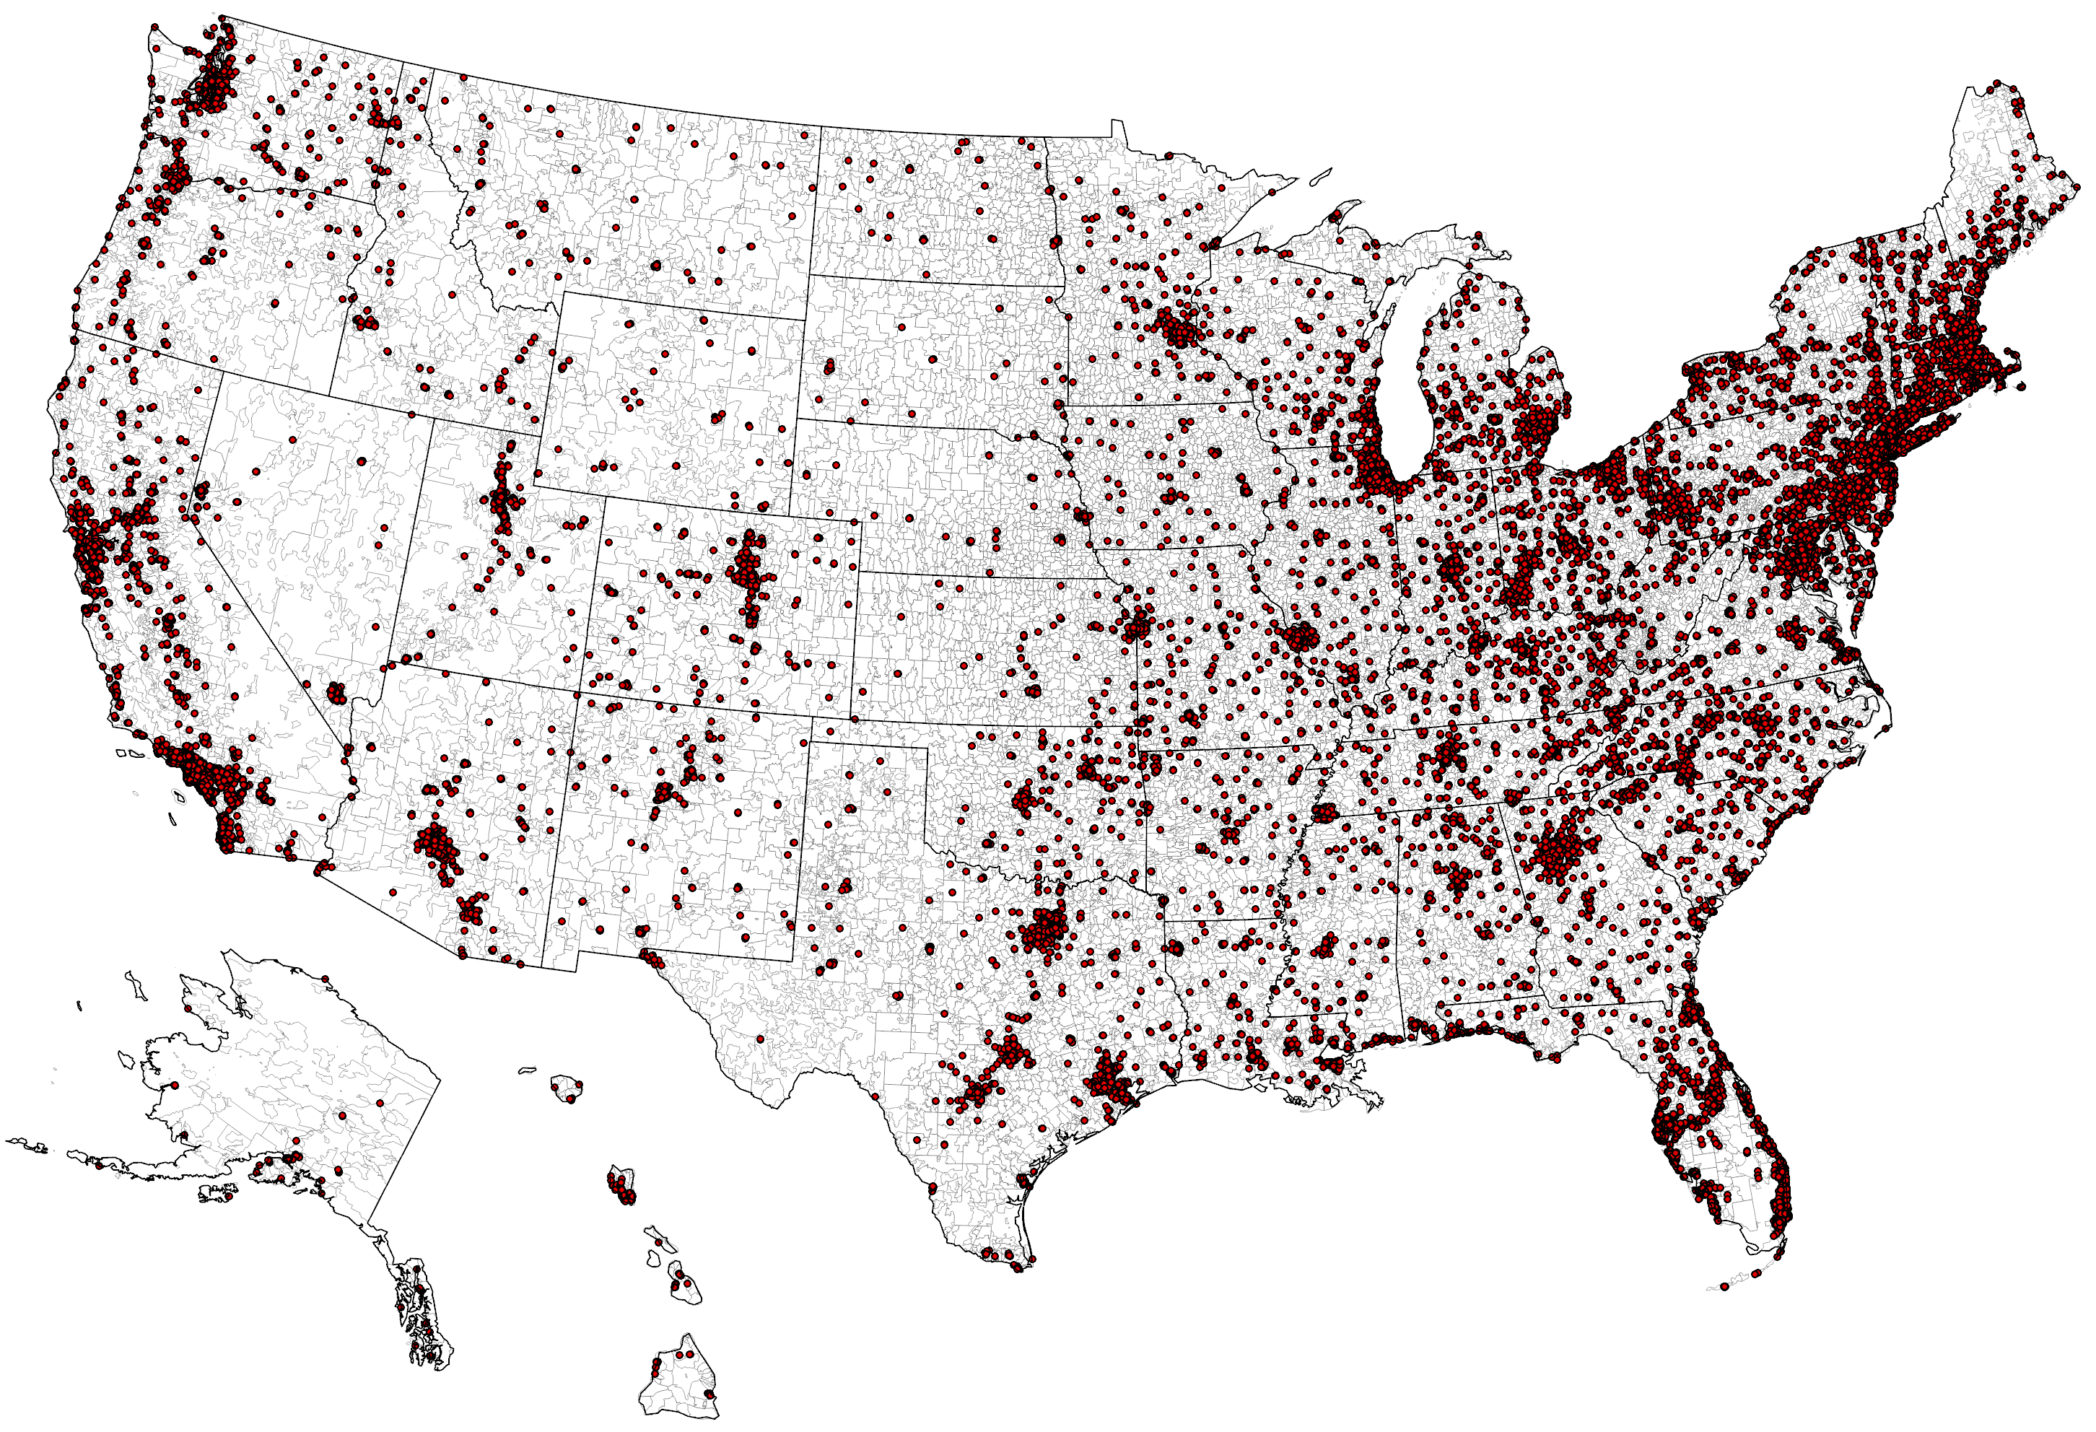
Buprenorphine Waivered Physicians in the United States, 2020
SOURCE: Substance Abuse and Mental Health Services Administration Buprenorphine Practitioner Locator
NOTE: Includes only practitioners who consented to release their practice information; does not include all waivered physicians in the United States

Slide 4
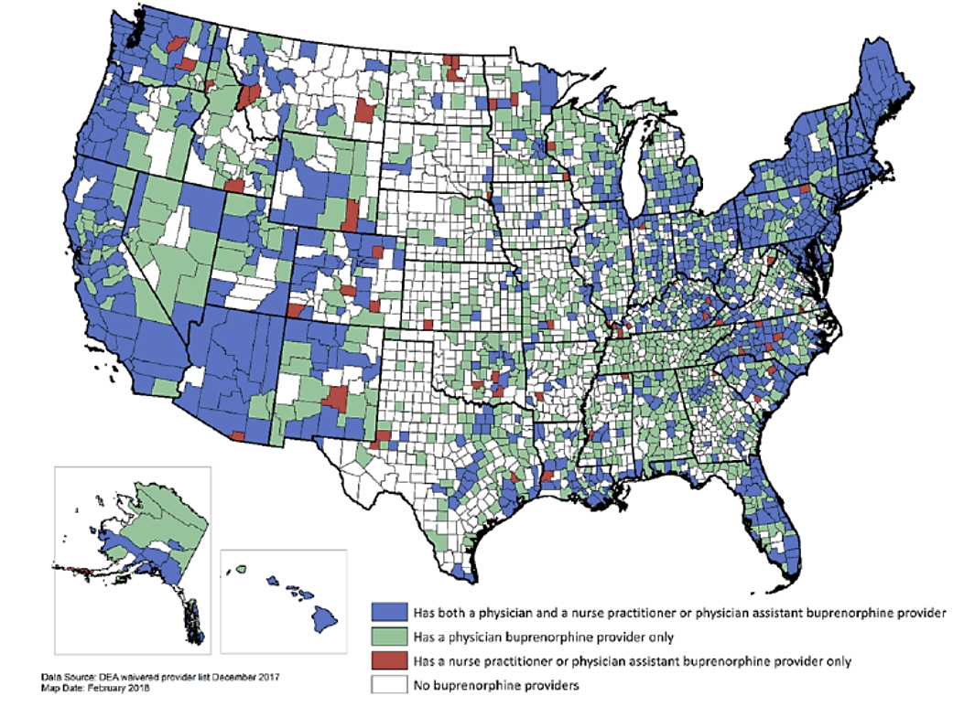
Counties with Buprenorphine Prescribers, 2017-18
SOURCE: Andrilla, C. H. A., Moore, T. E., Patterson, D. G., & Larson, E. H. (2019). Geographic distribution of providers with a DEA waiver to prescribe buprenorphine for the treatment of opioid use disorder: a 5‐year update. The Journal of Rural Health, 35(1), 108-112.

Slide 5
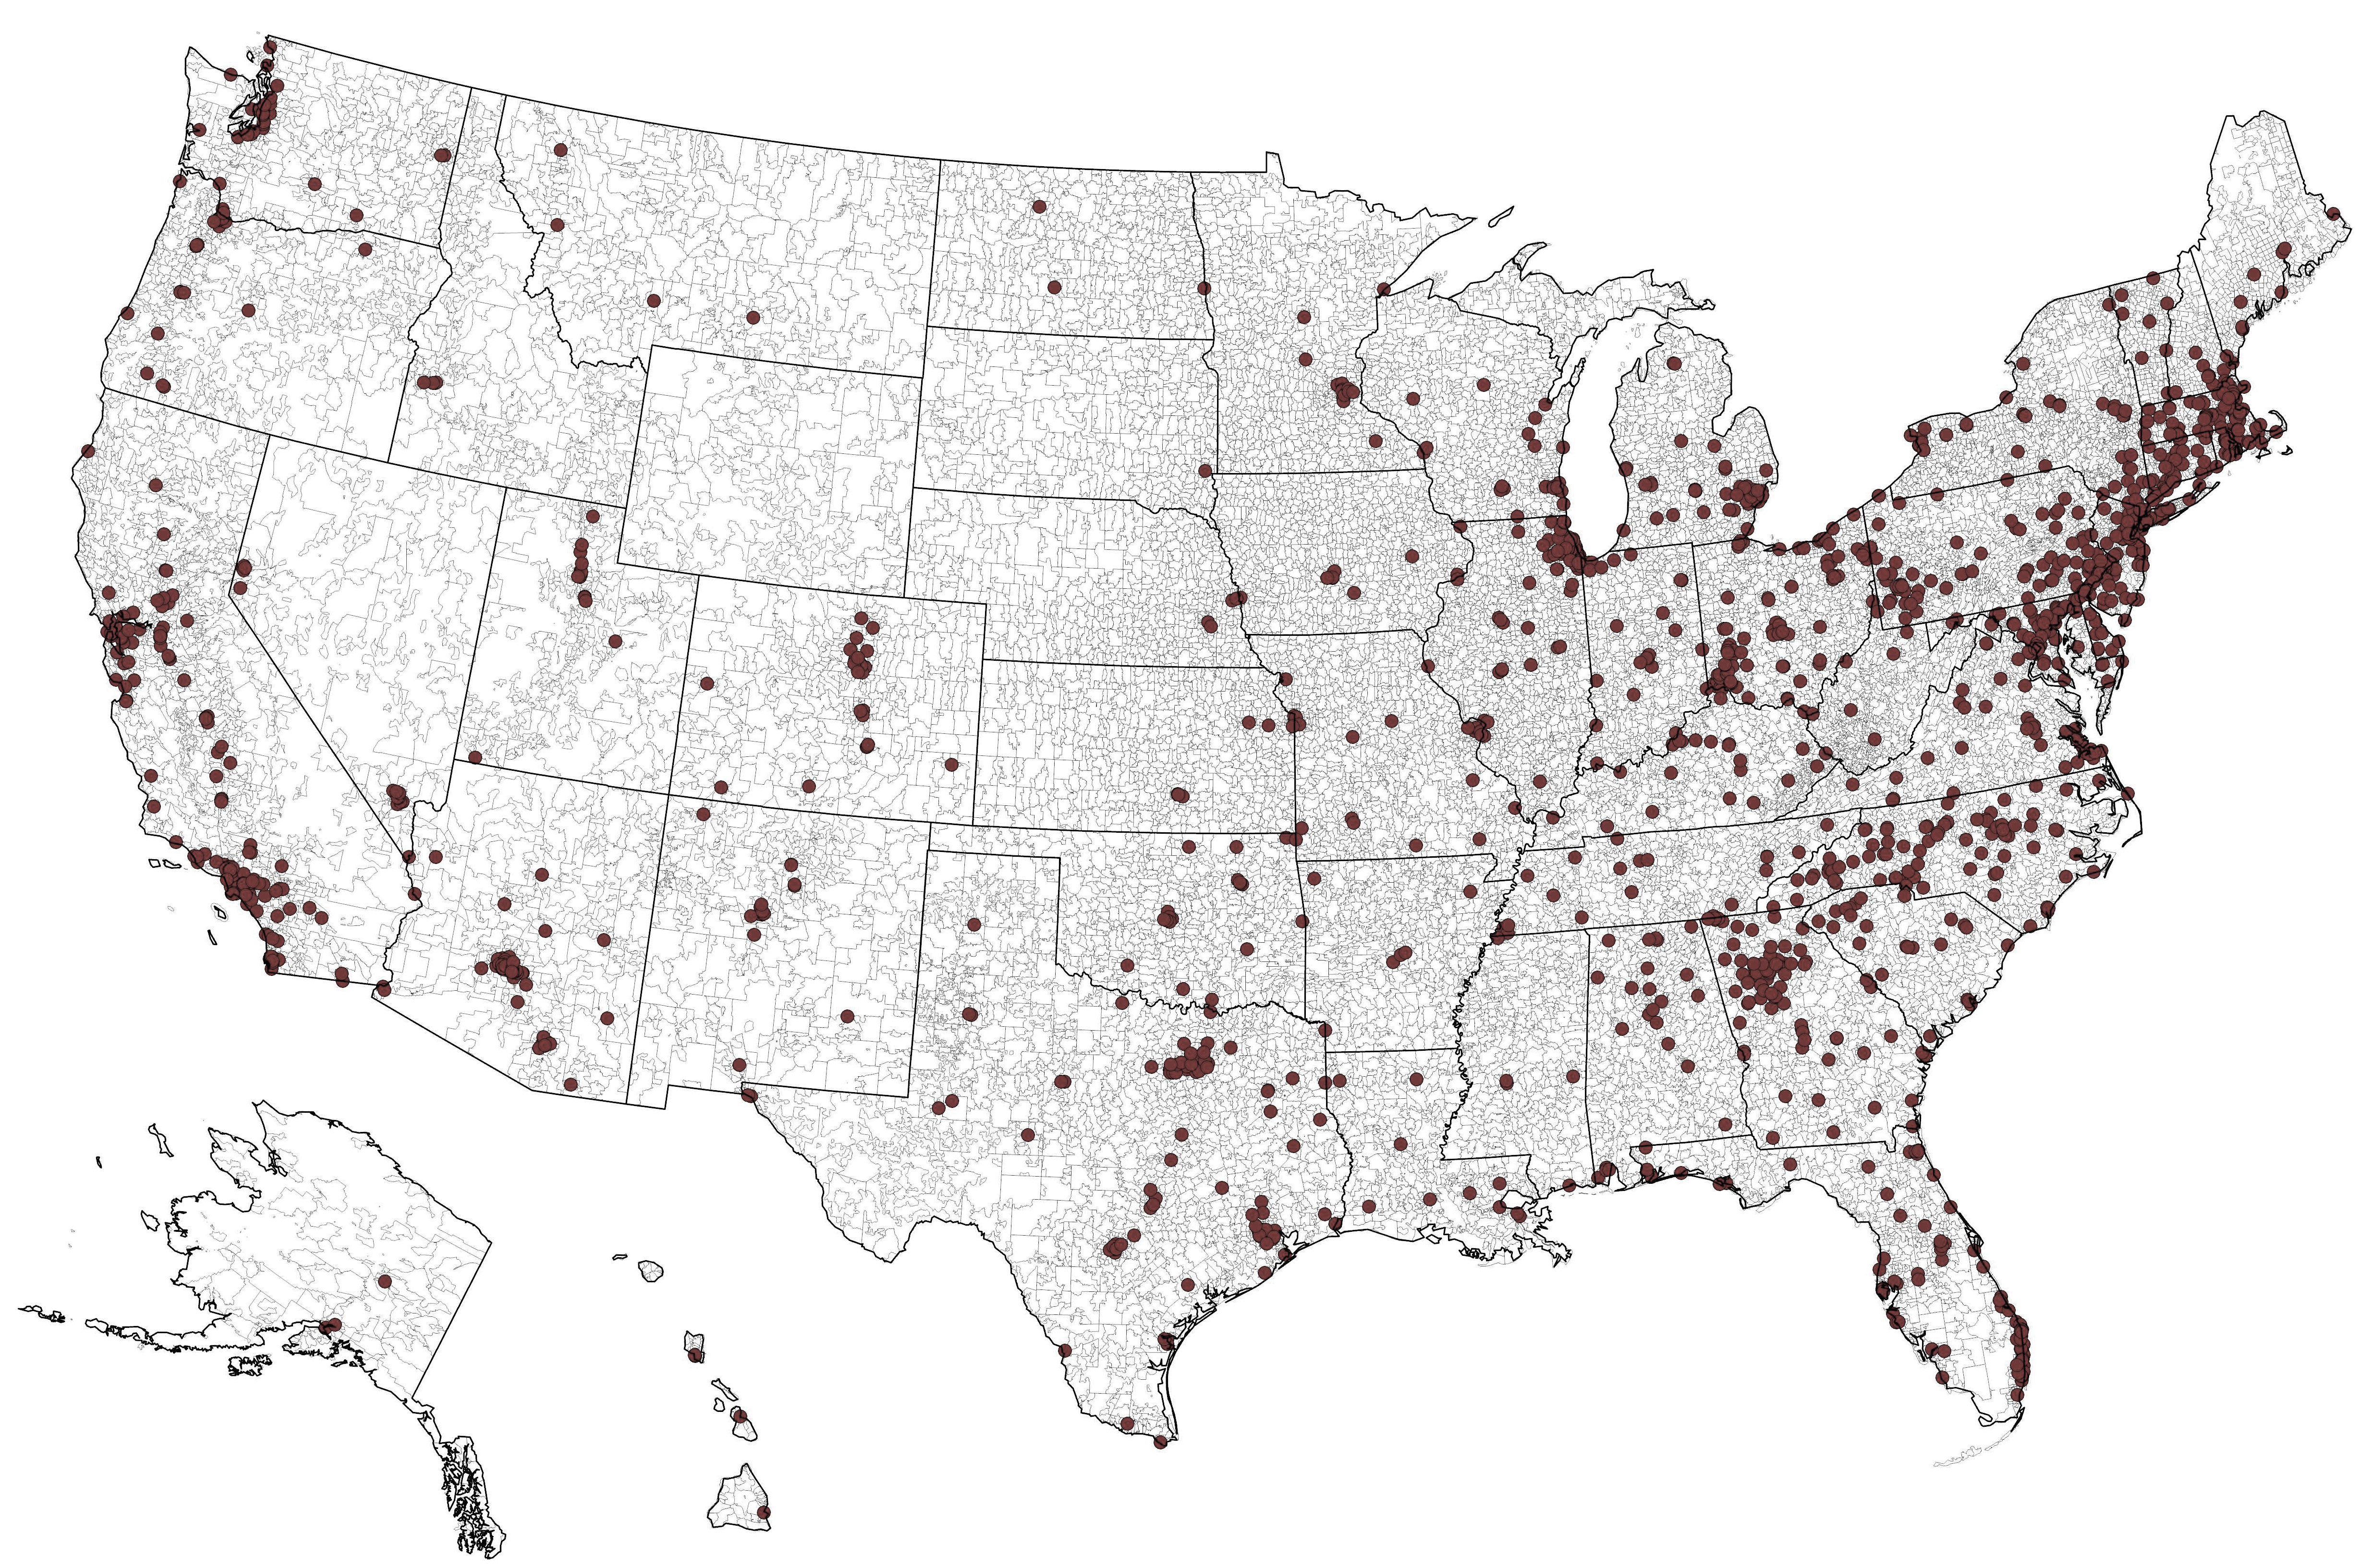
Licensed Opioid Treatment Programs in the United States, 2020
SOURCE: Substance Abuse and Mental Health Services Administration Behavioral Health Treatment Locator

Slide 6
recommendations
Making telehealth work
Expanded broadband access
Flexibility to states to use federal funds to pay for technology
Expanding workforce development efforts
Providers need qualified staff to expand capacity to prescribe and provide services
Funds for workforce training in postsecondary institutions
Incentives to recruit and retain counselors in rural areas to address shortage
Expanded availability and accessibility of culturally competent services
Building treatment capacity in rural communities
Ensuring long-term, sustainable revenue sources for addiction treatment (e.g. Medicaid)
Supporting community heath centers in rural communities to build treatment capacity

Slide 7
Thanks
Christina M. Andrews, Ph.D.
Associate Professor
candrews@mailbox.sc.edu
@c_m_andrews

